Slide 1
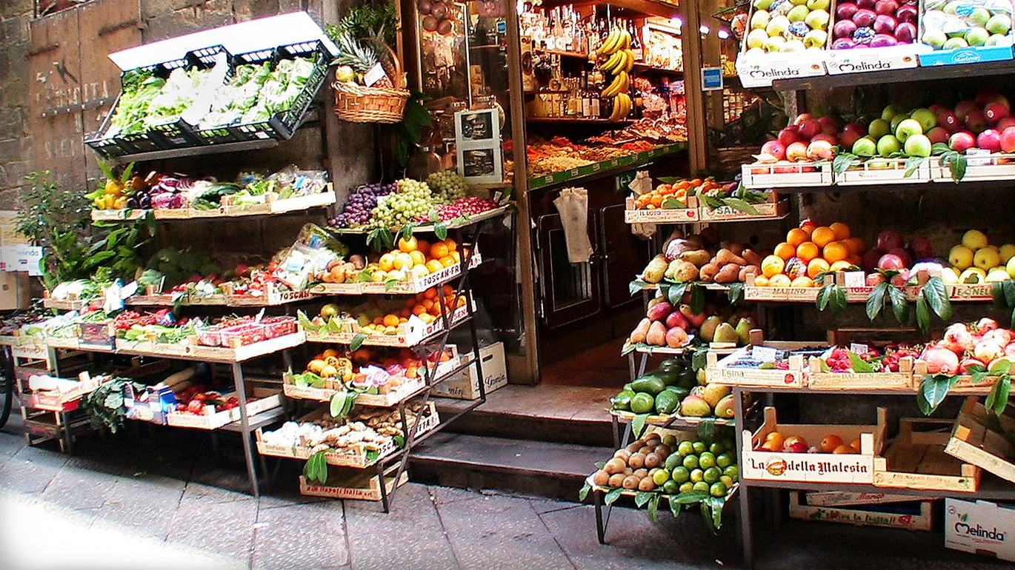
Raashan.com
Raashan.com is an E-commerce marketplace for your daily grocery shopping. It allows you to shop from your favorite store in your neighborhood and get delivery within 90 minutes. You can shop for groceries, Fruits & Vegetables, Bakery items, and with just a few taps.
This Photo by Unknown author is licensed under CC BY-SA.

Slide 2
Batch 3 Team 1
MEMBERS : NEETIKA VYAS
: NEHAL SAINI
: RAMAN DAHIYA
: RITURAJ BAILWAL
: SWAPNIL KUMAR

Slide 3
Contents
Online Delivery System
Project Specification
Business Requirements Specification (BRS)
Tools Used
Architecture Diagram
Use-Case Diagram
Advantages/Benefits
Challenges of e-Grocery
Key Challenges
Modules
Conclusion

Slide 4
Online Delivery System
The first method of delivery involves shipping groceries using a courier service if the order contains cold or frozen items.
The second method of grocery delivery is personal delivery. The most common type of personal delivery involves storing grocery inventory in a warehouse to deliver to customers once orders are placed..!

Slide 5
Project Specification
HTML: HTML is an acronym that stands for HyperText Markup Language which is used for creating web pages and web applications. HyperText simply means “Text within Text”. A text has a link within it, which is a hypertext. Whenever you click on a link that brings you to a new webpage, you have clicked on a hypertext.
Python: Python is a computer programming language often used to build websites and software, automate tasks, and conduct data analysis. Python is a general-purpose language, meaning it can be used to create a variety of different programs and isn't specialized for any specific problems.

Slide 6
Project Specification
Flask: Flask is a small and lightweight Python web framework that provides useful tools and features that make creating web applications in Python easier. It gives developers flexibility and is a more accessible framework for new developers since you can build a web application quickly using only a single Python file.
SQLITE3:Python SQLite3 module is used to integrate the SQLite database with Python. It is a standardized Python DBI API 2.0 and provides a straightforward and simple-to-use interface for interacting with SQLite databases.

Slide 7
BRS - Background of the Project
In today’s digital era, everything is just a tap away. Whether you have to order food, do shopping, transfer money, book a cab, or more, all of these are just a few taps on your smartphone.
Just like shopping for other items, online order of grocery items is gaining popularity worldwide. And, while grocers and shopkeepers are leaving no stone unturned to leverage this emerging trend.
The focus is now on investing in developing user-focused apps to meet the continuously increasing demand. You would be surprised to know besides convenience people realized the absolute necessity of such services during the COVID-19 lockdown phase.
So, if you are someone managing a startup, an established retailer, or an enterprise willing to invest in grocery mobile app development with an aim to boost business, you’ve come to the right place. We might have all the answers.

Slide 8
BRS - Goal of the Project
Raashan.com aims to provide a seamless grocery shopping experience with best-in-class service and user interface.
With an overwhelming amount of options to choose from, our app is without a cloud doubt one of the best in the market.
When a customer places an order for preferred goods, the ordered goods are delivered to the customer’s doorstep at the stipulated time.

Slide 9
BRS - Problem Statement
Online shoppers will experience the same great prices and sales as our in-store shoppers, making for an affordable experience that anybody will enjoy.
Buy in Bulk with Ease
Cut Gas and Parking Costs
Browse on Your Time, whether it’s 2 o’clock in the afternoon or 4 o’clock in the morning
Avoid the Line and Shop in the comfort of your home.
Grocery shopping online for home delivery allows you the pleasure of shopping from your dining room table, your couch, or your office, without navigating crowded aisles and lengthy cashier lines.

Slide 10
BRS - Solution
Proposed system will be an online grocery shopping website where products will be stored in an SQLite database and will be displayed on a webpage. New Products will be popped from the database and displayed on the homepage.
Admin can make product entries, control product management flow, view order, and track status entries.

Slide 11
BRS - Users
General public
Household workers
Restaurants

Slide 12
BRS - Requirements
Key factors for grocery Delivery System:
1. Login Module (Admin and User)
2. Track & Manage Customer Problems
3. Create a Customer Problem Report
4. Apply to price
5. Administrative functions

Slide 13
Tools Used
Python
Flask
HTML5
Robot
CSS
SQLite3

Slide 14
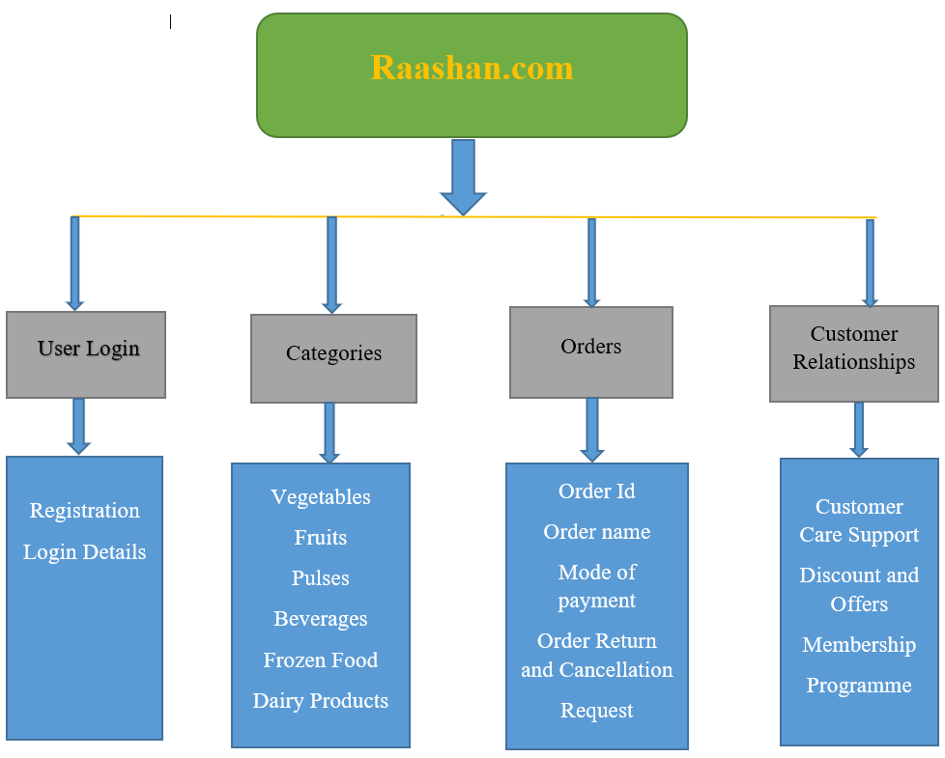
Architecture Diagram

Slide 15
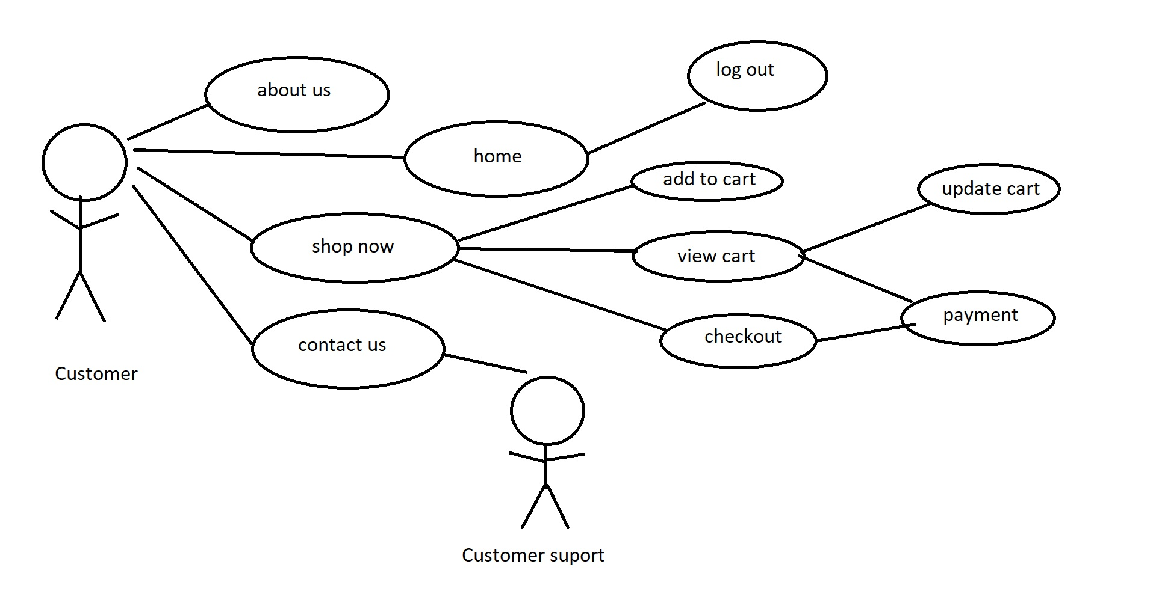
Use-Case Diagram

Slide 16
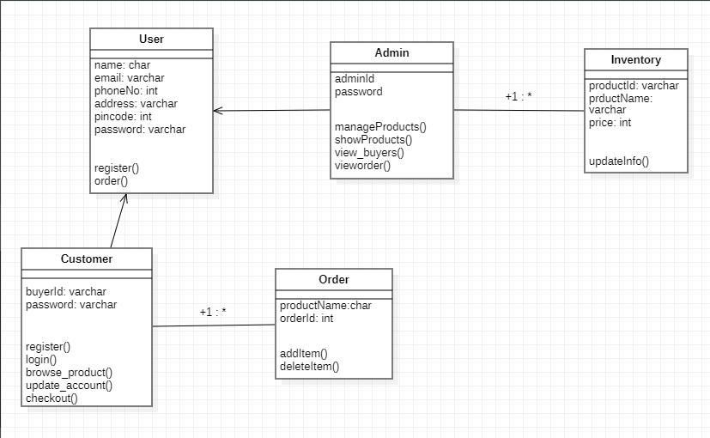
Class Diagram

Slide 17
Advantages/ Benefits
It saves time and energy – you don't have to waste your time going to stores, dealing with the crowd, and standing in lines.
24/7 availability – online grocery stores are open round the clock 24/7. The availability of online stores gives you the freedom to shop at your own convenience
Variety – another advantage of e-grocery is variety. You can visit many stores to find the same selection.
Comparison of prices – it allows you to easily check prices and compare with just a few clicks
Customers are usually satisfied - nowadays shopping online is very reliable. customers can give feedback and reviews.

Slide 18
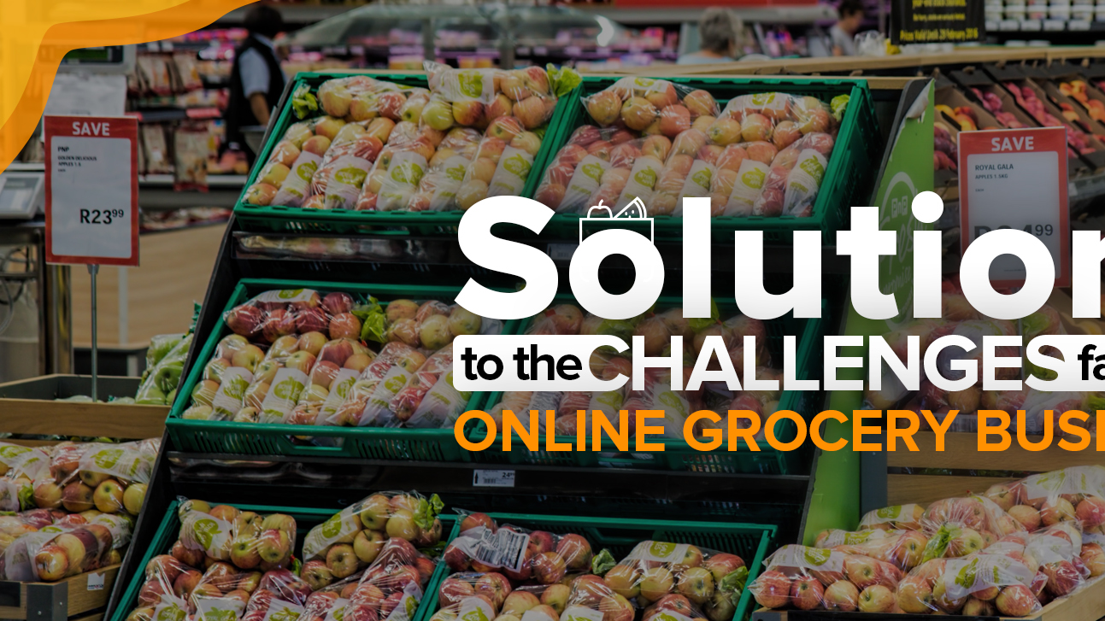
Challenges Of e-Grocery
1. Less control over freshness and quality when shopping online.
2. Delivery Issues – delivery charges must vary low and high according to the location.
3. The anonymity of online shopping - you won't have human interaction except for the delivery person.

Slide 19
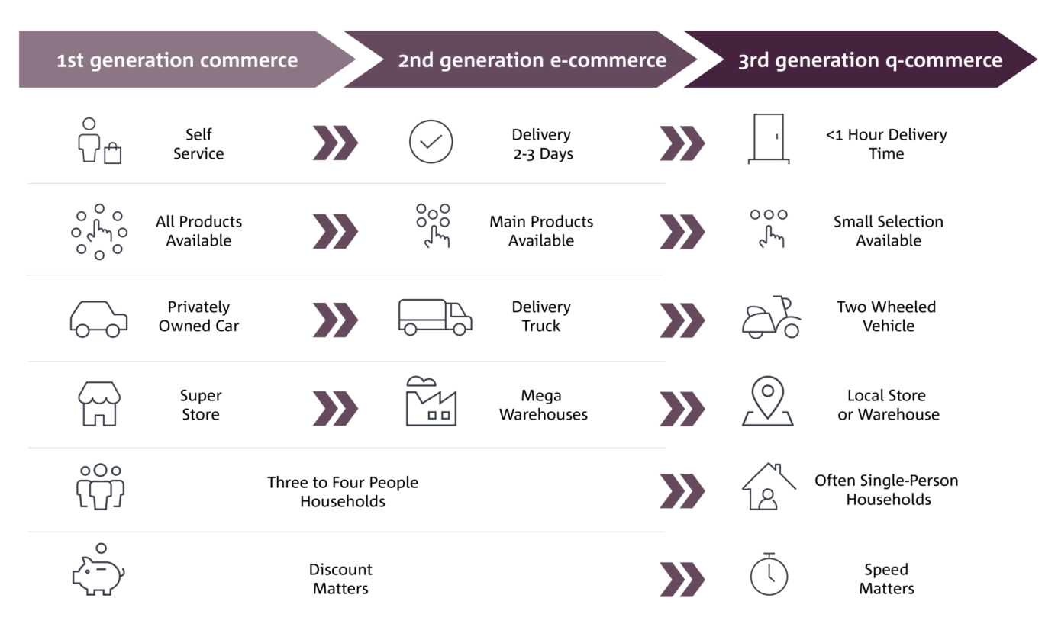
Key Challenges in Operating the e-Grocery Model

Slide 20
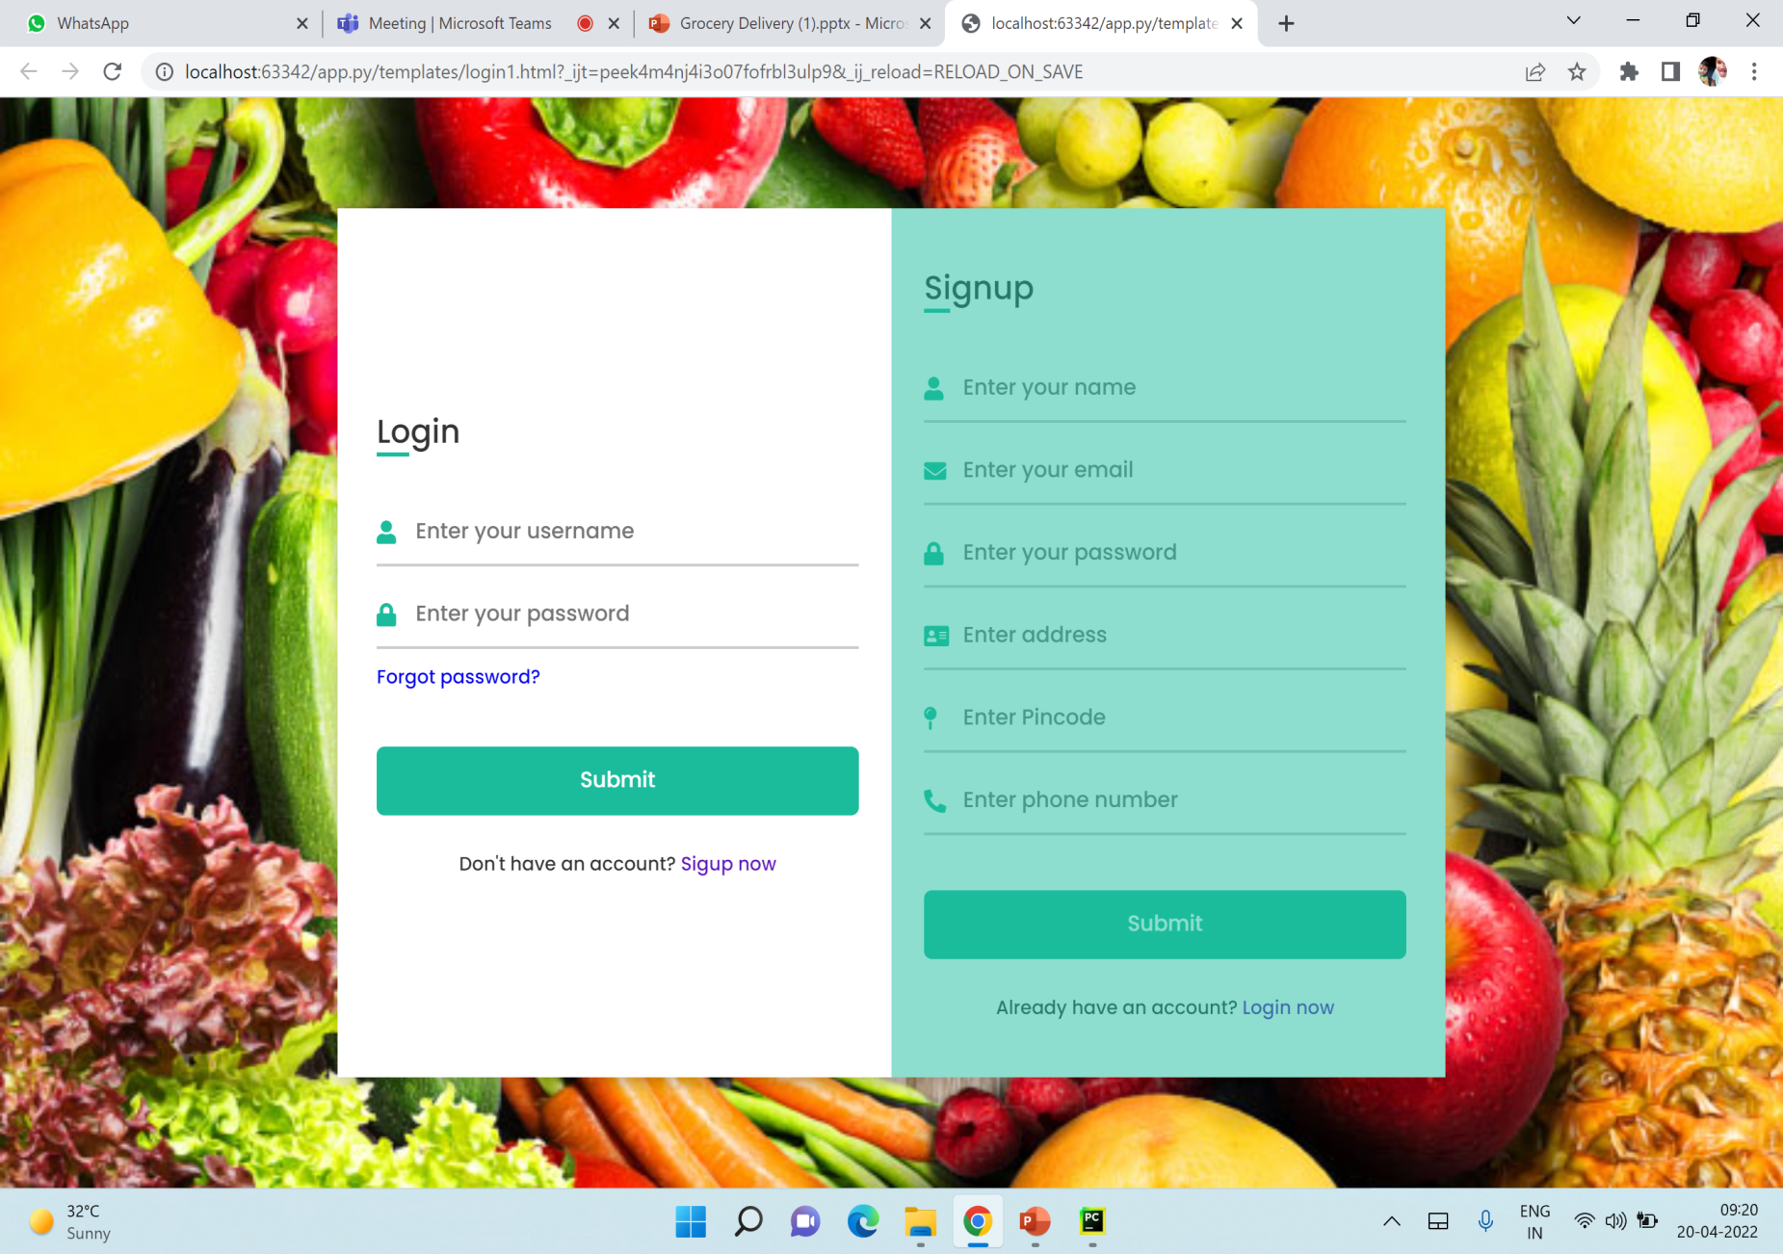
Login
This is the login template of our project. The user or admin is asked the login to get into the homepage or admin module.

Slide 21
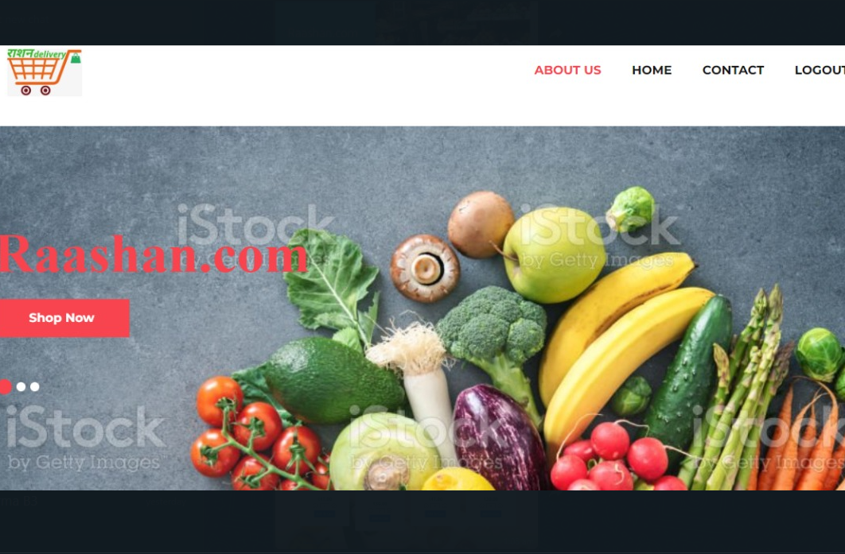
Homepage
The user is asked the log in to get into the homepage.

Slide 22
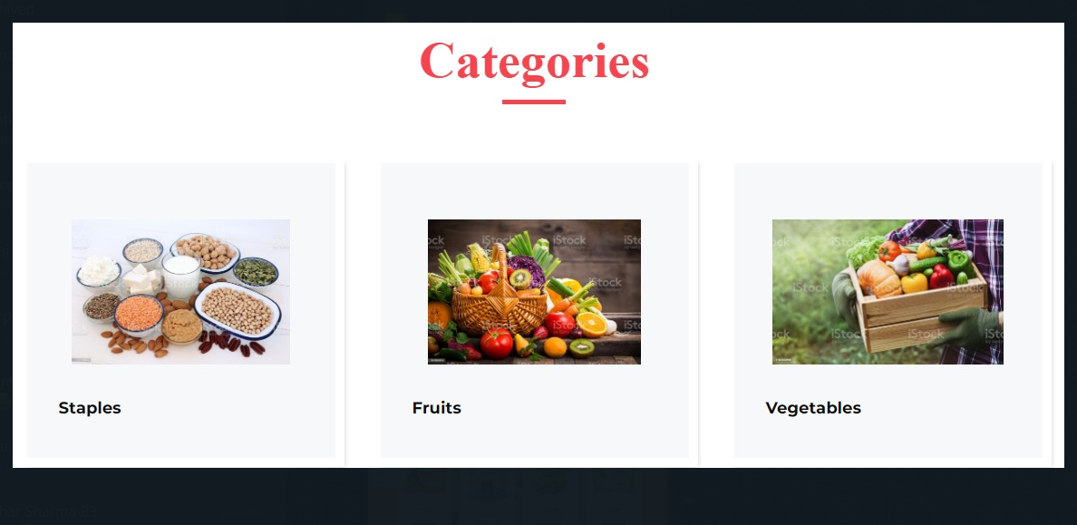
Categories
We have created a smooth UI experience with a navbar hovering contents.

Slide 23
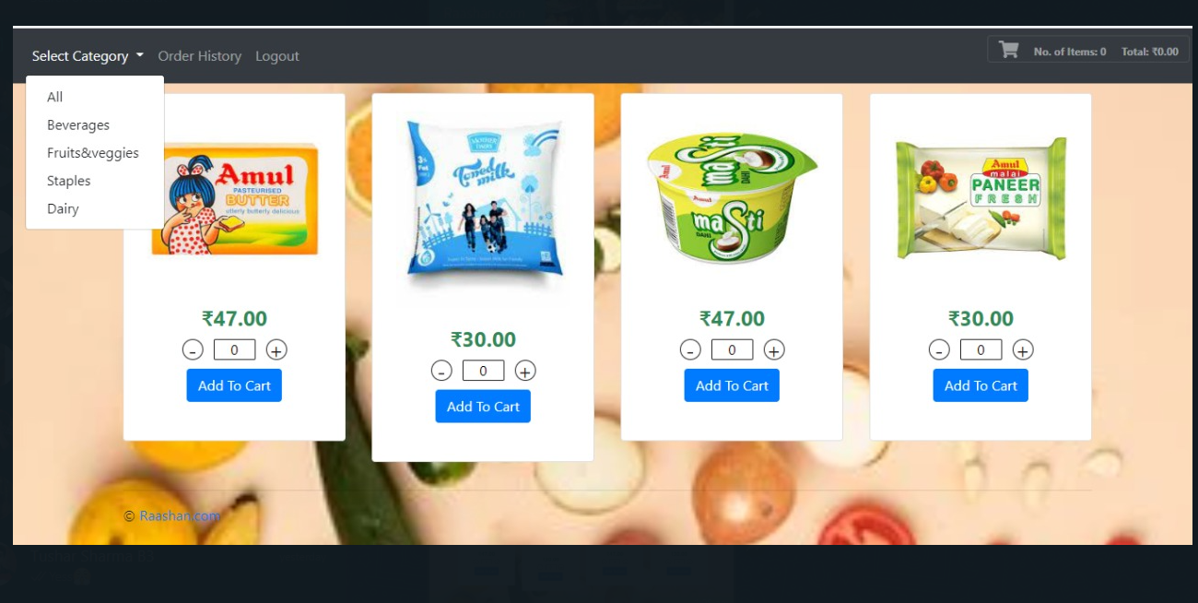
Select Category
The user can select from the following categories.

Slide 24
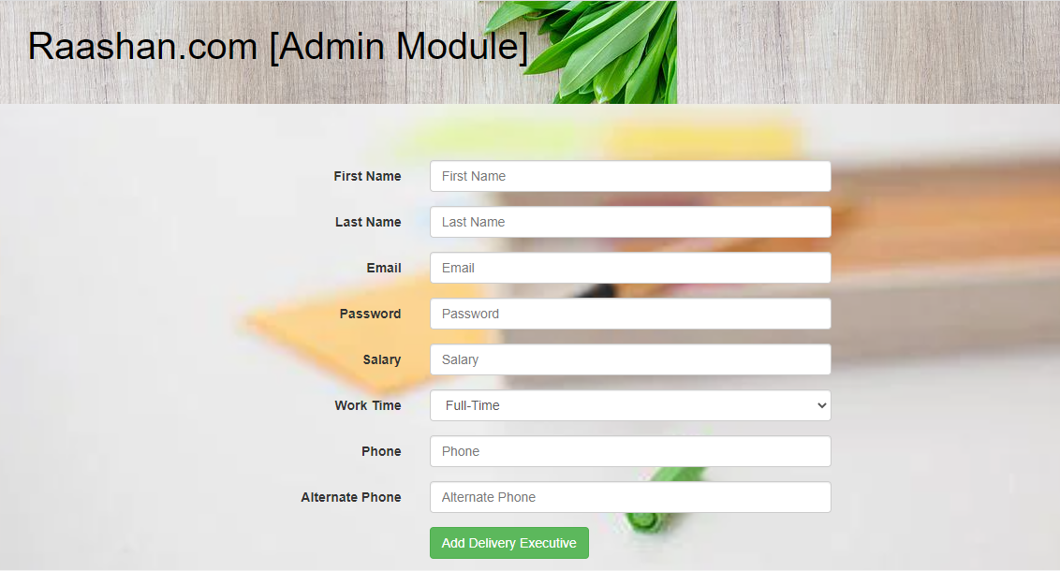
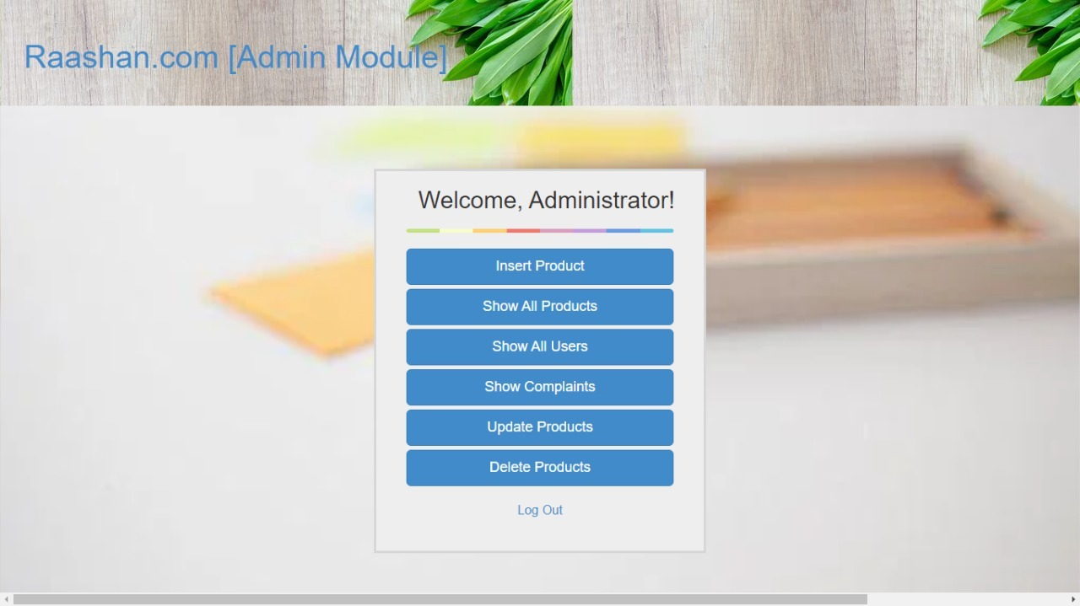
Admin
The admin can perform all the following operations.

Slide 25
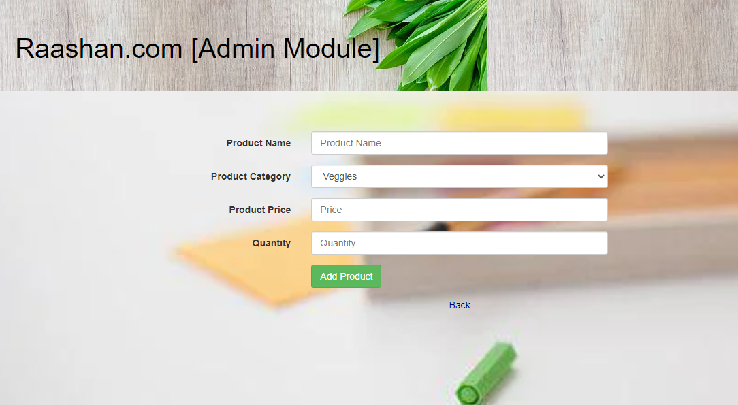
Admin Module
Admin can insert all products details.

Slide 26
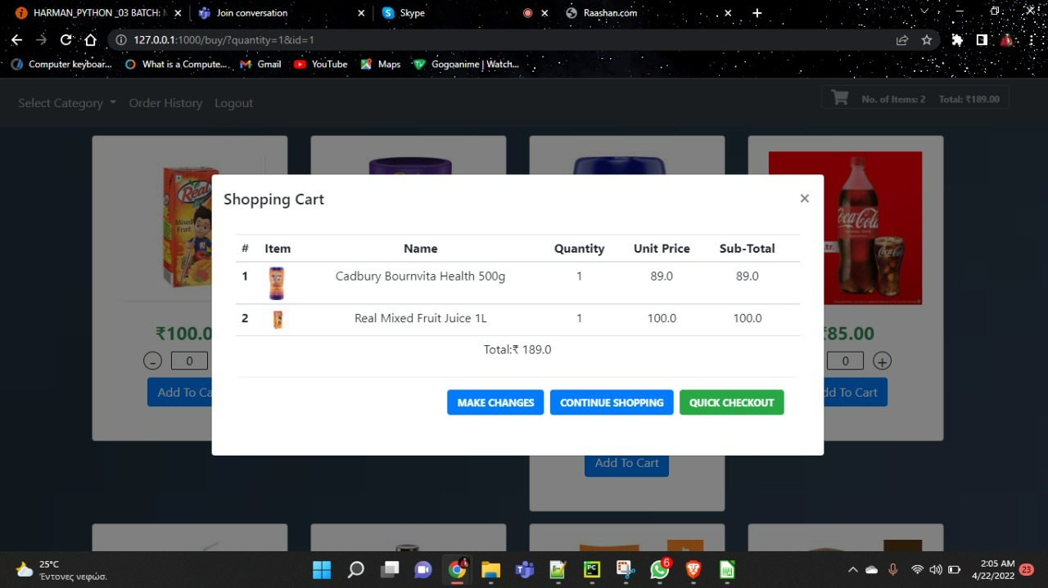
Add to Cart
Items added to the cart will be shown here.

Slide 27
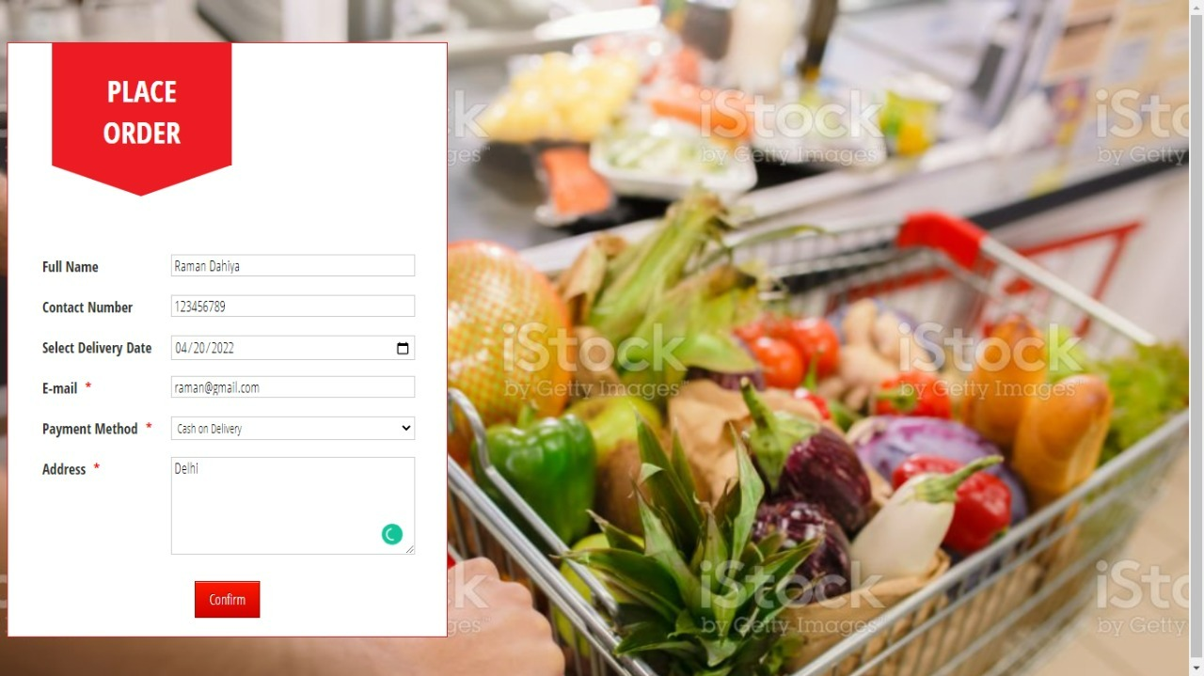
Place Order

Slide 28
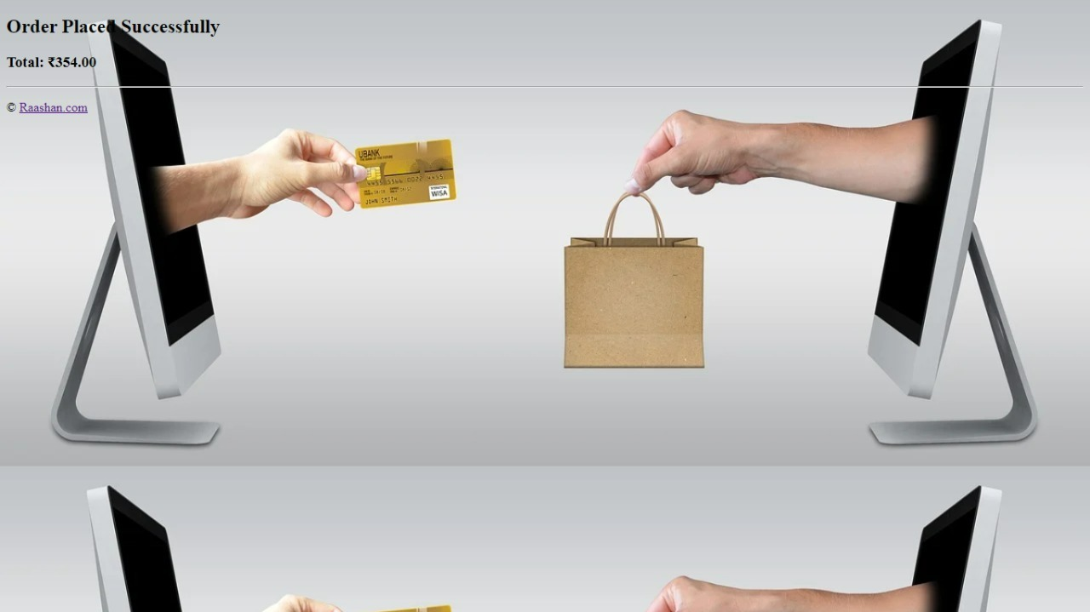
Order Placed Successfully

Slide 29
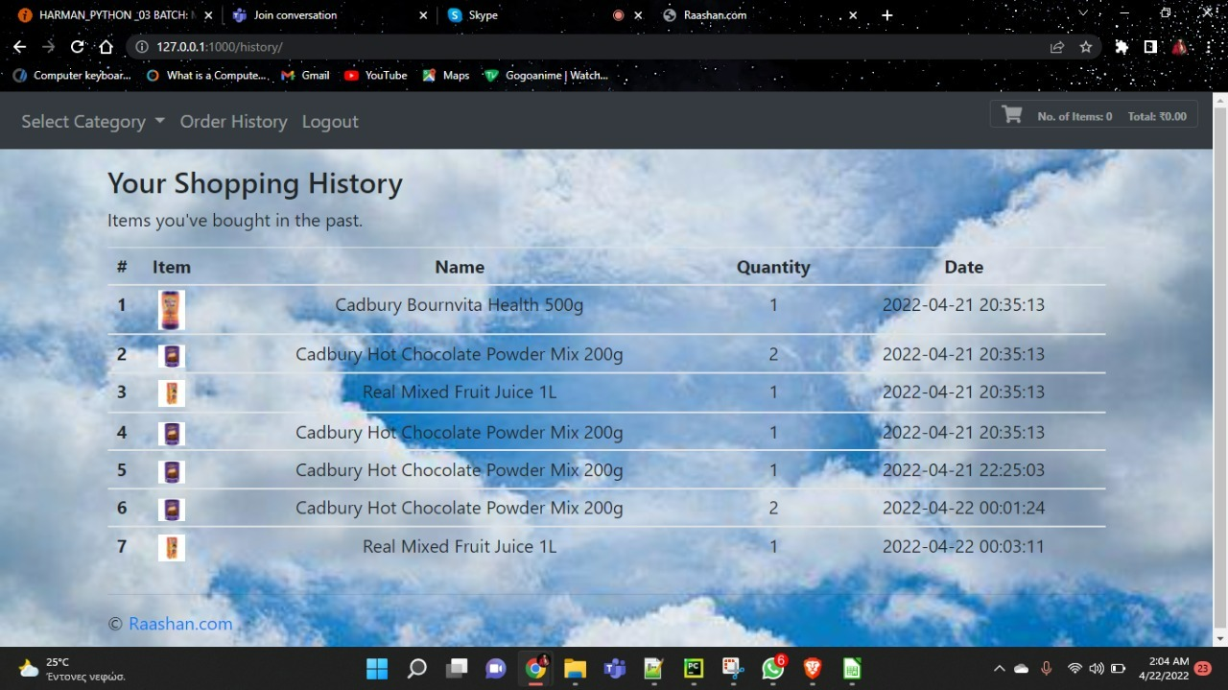
Order History
The users can view their order history from here.

Slide 30
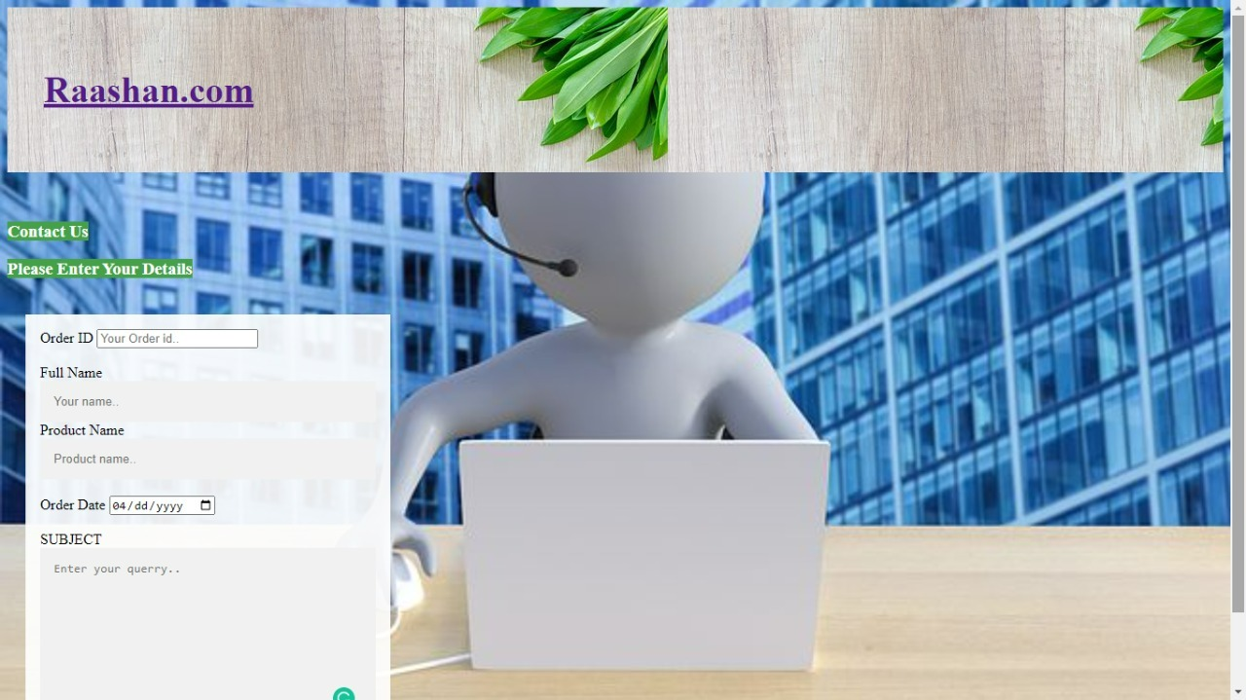
Support
The user can register complaints and also give their reviews.

Slide 31
Conclusion
Online grocery services meet a number of consumer needs including providing products for niche markets or helping the time-starved consumer shop for the routine weekly groceries.
Handicapped and age can participate in the shopping experience. Online shopping makes it convenient for them.

Slide 32

THANK YOU!!
MEMBERS : NEETIKA VYAS
: NEHAL SAINI
: RAMAN DAHIYA
: RITURAJ BAILWAL
: SWAPNIL KUMAR

Slide 33
